Slide 1
Ensuring Trustworthiness and High Quality
Paul Raff
STRATA 2018 Tutorial

Slide 2
Objectives
Understand how we deal with the analysis component of experimentation.
Three main areas:
The data pipeline
Analysis mechanisms
Proper interpretation of analysis results
Ultimately, we need to ensure that what you are looking at is a proper reflection of the experiment you are running.
In other words, achieving External Validity.

Slide 3
The Data Pipeline
Your analysis is only as good as the data which produces it.

Slide 4


The Data Pipeline Basic Diagram
A data pipeline, at its core, takes in raw events and processes them to a consumable form.
Servers/Clients
Raw Events
Data Processing
“The Cooker”
Consumable Data
“Cooked Logs”

Slide 5
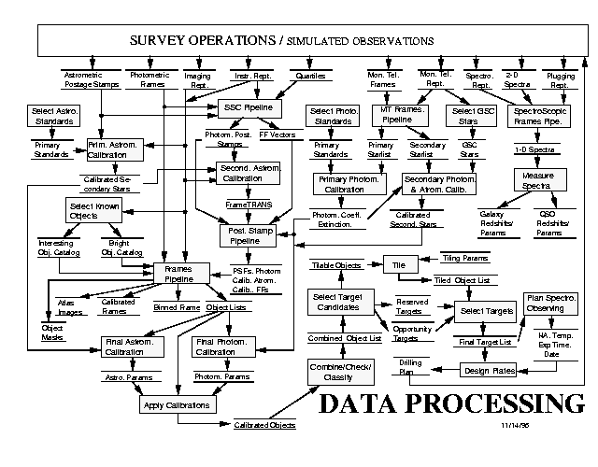
The Data Pipeline In reality, looks something like this
How do we ensure that your data makes it out in a legitimate form?

Slide 6
No Data Left Behind
Can also be called The Principle Of Conservation Of Data.
Any data that enters a data pipeline should exist in some output of the data pipeline.
Failure to adhere yields a version of the Missing Data Problem.

Slide 7
No Data Left Behind
A common example – client-side and server-side telemetry have separate raw logs. A snapshot is taken daily and joined together via a common join key.
Client-side logs can arrive late, resulting in some of the logs not being able to be joined in the daily snapshot.
08/05
08/06
08/07
Server-side logs
08/04
08/05
08/06
08/07
Client-side logs

Slide 8
No Data Left Behind
Incorrect (but common) method –
Only keeping the data each day that matches, discarding the rest.
Correct methods –
Exposing unmatched client-side/server-side data points along with the full matched data set.
Reprocessing multiple previous days together to increase the matching of the client/server data. This results in a tradeoff between data latency and completeness.

Slide 9
Your Experiment Can Influence The Data Pipeline!
Primary example: bot traffic.
If your treatment causes more/less traffic to be classified as bot traffic – typically excluded by default in analyses – then you are biasing your analysis.
How to know if the data pipeline is the root cause:
Be able to assess randomization as early in the data pipeline as possible, to separate out bad randomization from an issue in the data pipeline.

Slide 10
Key Mechanisms for Ensuring Trustworthiness
These mechanisms fall into two forms:
Global – mechanisms that exist as part of your experimentation platform.
Local – mechanisms that exist for each individual experiment/analysis performed.

Slide 11
Global Mechanisms

Slide 12
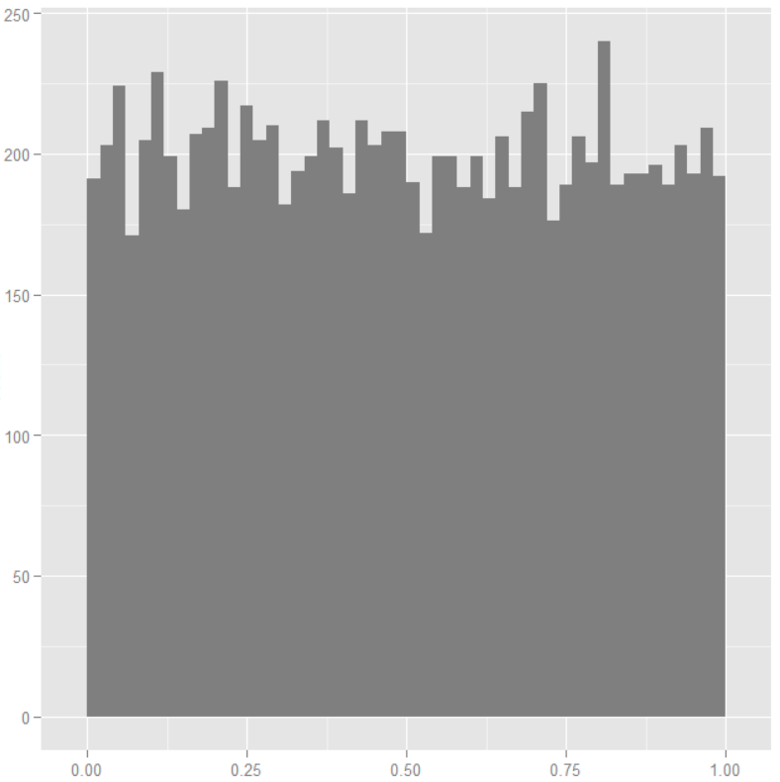
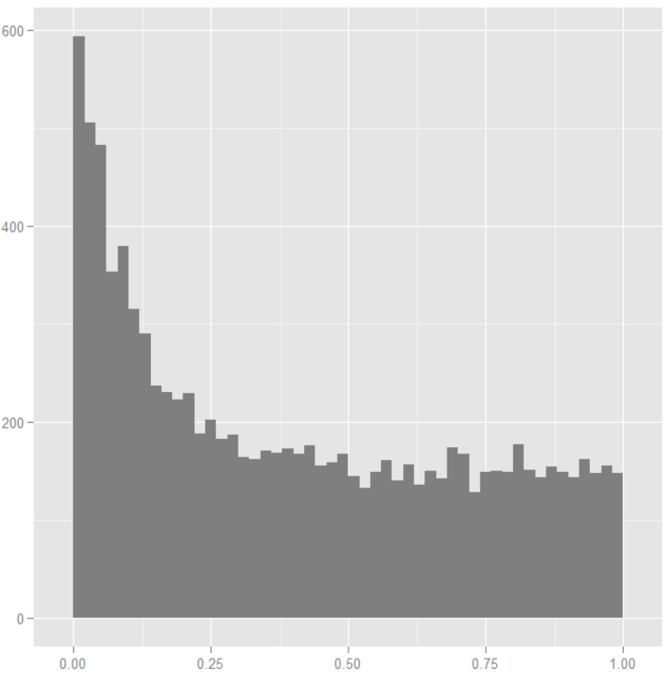
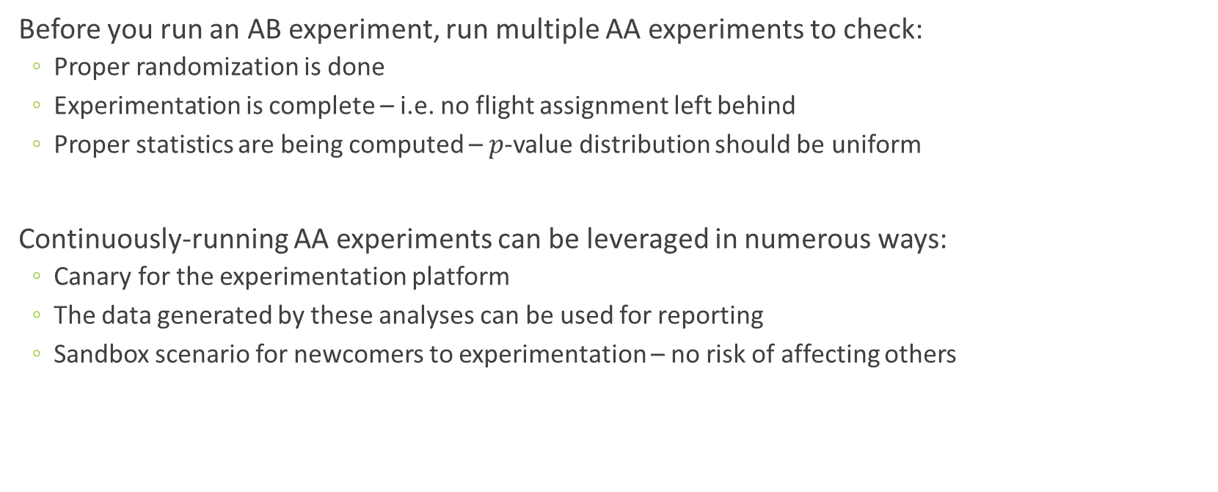


Global Mechanisms The All-Important AA
Good $p$-values in an AA
Before you run an AB experiment, run multiple AA experiments to check:
Proper randomization is done
Experimentation is complete – i.e. no flight assignment left behind
Proper statistics are being computed – $p$-value distribution should be uniform
Continuously-running AA experiments can be leveraged in numerous ways:
Canary for the experimentation platform
The data generated by these analyses can be used for reporting
Sandbox scenario for newcomers to experimentation – no risk of affecting others
Bad $p$-values in an AA
R. Kohavi, R. Longbotham, D. Sommerfield, R. Henne, “Controlled Experiments on the Web: Survey and Practical Guide," in Data Mining and Knowledge Discovery, 2009.

Slide 13
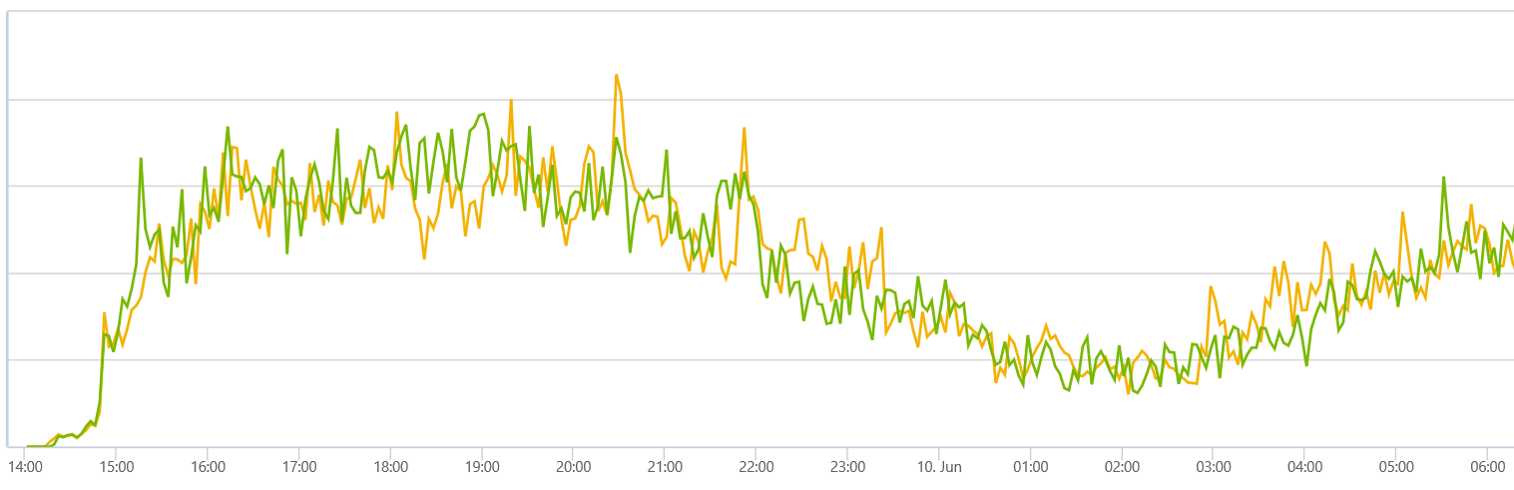
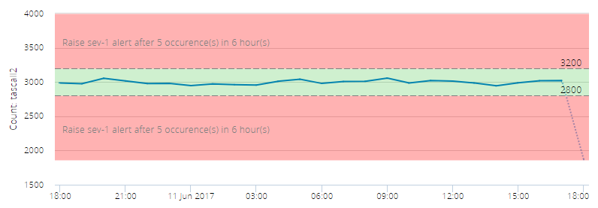
Global Mechanisms Real-time Analytics
It’s helpful to observe the state of each experiment as it’s running, and to also continuously stress-test the assignment component.
Screenshot of real-time counters of flight assignment
Screenshot of real-time monitoring of randomization

Slide 14
Global Mechanisms The Holdout Experiment
Experimentation incurs a cost to the system, and we can utilize experimentation itself to accurately measure the cost.
Useful as a way to separate out the effect in the context of broader changes observed to the system (i.e. performance regression).
Holdout Experiment
Experiment 1
Experiment 2
Experiment Space
…
…
…
…
…
User Space

Slide 15
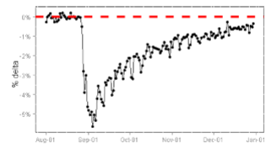
Global Mechanisms Carry-over Effects
Carry-over effects are real, and can affect your experiments if not handled appropriately.
Re-randomization techniques can be used to ensure that impact from previous experiments can be distributed evenly in your new experiment.
R. Kohavi, R. Longbotham, D. Sommerfield, R. Henne, “Controlled Experiments on the Web: Survey and Practical Guide," in Data Mining and Knowledge Discovery, 2009.

Slide 16
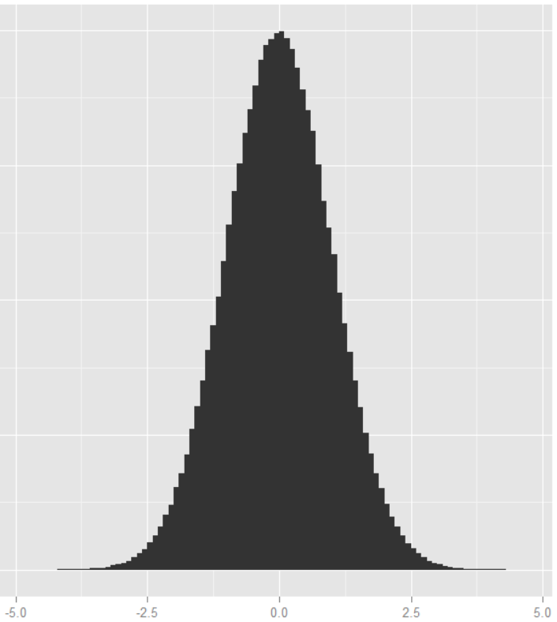
Global Mechanisms Seedfinder
It’s known that:
The measured difference between two random subsets of a population can differ over a range.
This difference persists over time.
Therefore, we want to choose the randomization that minimizes this difference.
Observed differences between two groups
1MM randomizations

Slide 17
Global Mechanisms Seedfinder
It’s known that:
The measured difference between two random subsets of a population can differ over a range.
This difference persists over time.
Therefore, we want to (and can) choose the randomization that minimizes this difference.
We want this randomization!

Slide 18
Local Mechanisms

Slide 19
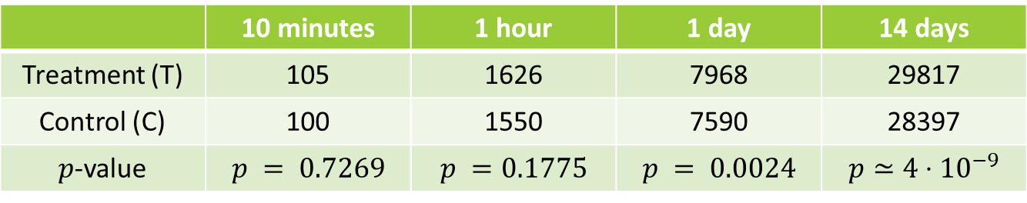

Local Mechanisms Sample Ratio Mismatch
$χ^{2}$ test against the observed numbers to check against the experiment setup. Example data from a 50%/50% experiment – note the same T/C ratio of 1.05 each time:
You can only run this test against the unit you actually randomize on. If you randomize by user, you cannot test the number of events per user, as that could be influenced by the treatment effect.
 | 10 minutes | 1 hour | 1 day | 14 days
Treatment (T) | 105 | 1626 | 7968 | 29817
Control (C) | 100 | 1550 | 7590 | 28397
$p$-value | $$p = 0.7269$$ | $$p =0.1775$$ | $$p = 0.0024$$ | $$p≃4⋅{10}^{−9}$$
R. Kohavi, R. Longbotham, “Unexpected Results in Online Controlled Experiments," in SIGKDD Explorations, 2009.
Z. Zhao, M. Chen, D. Matheson and M. Stone, "Online Experimentation Diagnosis and Troubleshooting Beyond AA Validation," in Conference on Data Science and Advanced Analytics, 2016.

Slide 20
Local Mechanisms Data Quality Metrics
As important as the Overall Evaluation Criteria are the data quality metrics that indicate issues with the data and/or the interpretation of metrics.
Examples:
Error rates – client errors, server errors, javascript errors.
Data validity rates – W3C performance telemetry, for example, are delayed. If the incidence of these validity rates differ between treatments, then that invalidates the W3C metrics.
Traffic/page composition rates – a change in the user’s initial traffic composition should be independent of the treatment effect, so any sharp changes here indicates an issue with experiment execution.
Any overall changes observed can influence a lot of other metrics in the analysis.

Slide 21
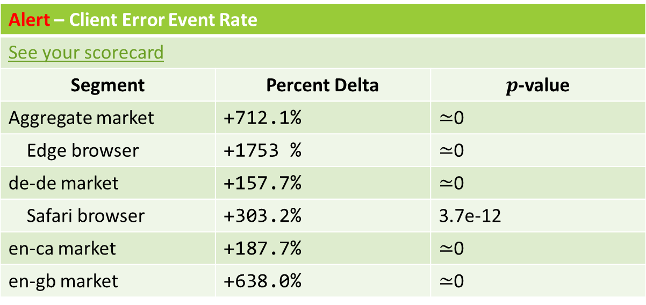
Local Mechanisms Proactive Alerting
Simple and effective proactive mechanism.
Alert – Client Error Event Rate
See your scorecard
Segment | Percent Delta | $p$-value
Aggregate market | +712.1% | $≃$0
Edge browser | +1753 % | $≃$0
de-de market | +157.7% | $≃$0
Safari browser | +303.2% | 3.7e-12
en-ca market | +187.7% | $≃$0
en-gb market | +638.0% | $≃$0

Slide 22
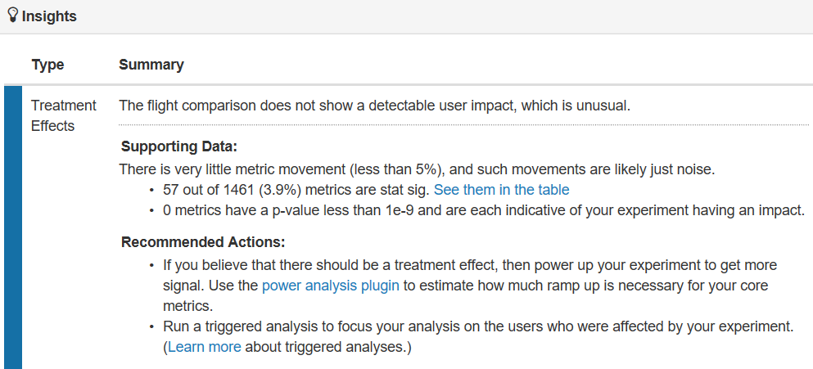

Local Mechanisms Treatment Effect Assessment
Simple and useful mechanism to prevent $p$-hacking and “fishing for statistical significance”.

Slide 23
Understanding Your Metrics

Slide 24
Understanding Your Metrics
Keys to success:
Trust, but verify: Ensure your experiment did what it was designed to do.
Go a second level: Have useful breakdowns of your measurements.
Be proactive: Automatically flag what is interesting and worth following up on.
Go deep: Build infrastructure to find good examples.

Slide 25
Understanding Your Metrics Trust, But Verify
Separate out primary effects from secondary effects. Validate your primary effects, and then analyze your secondary effects.
Example: Ads. If you run an experiment to show around 10% more ads on the page, you may be tempted to look straight at the revenue numbers. Upon observing this data, you may believe that there is something wrong with your experiment.
Metric | Treatment | Control | Delta (%) | $p$-value
Revenue Per User | 0.5626 | 0.5716 | +1.60% | 0.0596

Slide 26
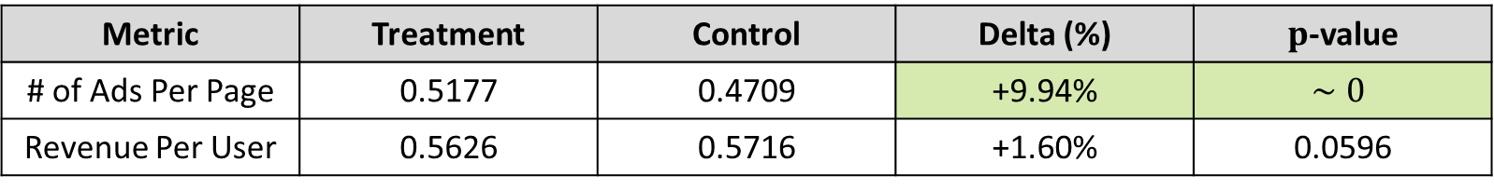
Understanding Your Metrics Trust, But Verify
Separate out primary effects from secondary effects. Validate your primary effects, and then analyze your secondary effects.
Example: Ads. If you run an experiment to show around 10% more ads on the page, you may be tempted to look straight at the revenue numbers.
However, you can confirm directly that you are doing what you intended, and now you have insight!
Metric | Treatment | Control | Delta (%) | $p$-value
# of Ads Per Page | 0.5177 | 0.4709 | +9.94% | $$∼0$$
Revenue Per User | 0.5626 | 0.5716 | +1.60% | 0.0596

Slide 27
Understanding Your Metrics Have Useful Breakdowns
This is only partially informative:
Metric | Treatment | Control | Delta (%) | $p$-value
Overall Page Click Rate | 0.8206 | 0.8219 | -0.16% | 8e-11

Slide 28
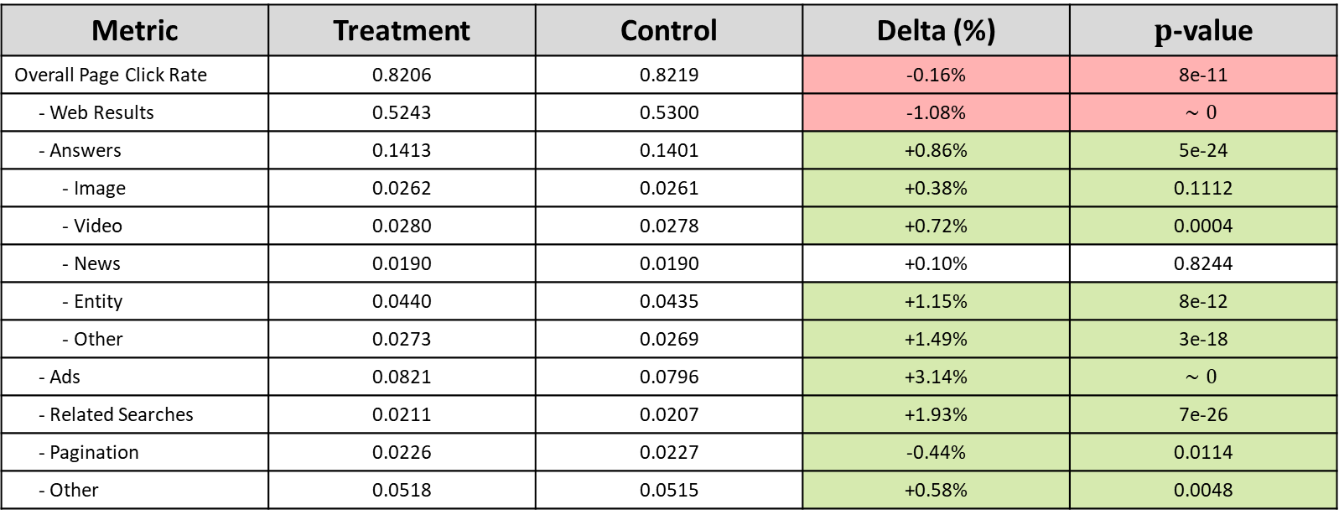
Understanding Your Metrics Have Useful Breakdowns
This is much more informative. Now we can better understand what is driving the change.
Metric | Treatment | Control | Delta (%) | $p$-value
Overall Page Click Rate | 0.8206 | 0.8219 | -0.16% | 8e-11
- Web Results | 0.5243 | 0.5300 | -1.08% | $$∼0$$
- Answers | 0.1413 | 0.1401 | +0.86% | 5e-24
- Image | 0.0262 | 0.0261 | +0.38% | 0.1112
- Video | 0.0280 | 0.0278 | +0.72% | 0.0004
- News | 0.0190 | 0.0190 | +0.10% | 0.8244
- Entity | 0.0440 | 0.0435 | +1.15% | 8e-12
- Other | 0.0273 | 0.0269 | +1.49% | 3e-18
- Ads | 0.0821 | 0.0796 | +3.14% | $$∼0$$
- Related Searches | 0.0211 | 0.0207 | +1.93% | 7e-26
- Pagination | 0.0226 | 0.0227 | -0.44% | 0.0114
- Other | 0.0518 | 0.0515 | +0.58% | 0.0048
Notes:
Reference rules of thumb paper?

Slide 29
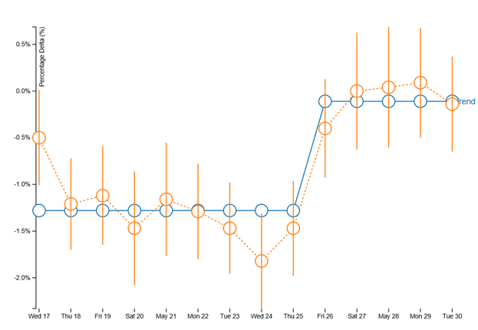
Proactively Flag Interesting Things
Heterogeneous treatment effects should be understood and root-caused.
Typically, we expect the treatment effect to either be fully consistent over time or demonstrating a novelty effect.
Sudden shifts like the one shown here indicate an externality that affected the treatment effect .
Notes:
http://exp/xCard/?view=9a07d329-989a-4633-9dfd-e727810846da

Slide 30
Go Deep – Find Interesting Examples
Going back to the error rate example, we can intelligently identify which errors are most likely to be causing the movements observed:
Rank | Error Text | # - Treatment | # - Control | Statistic | Examples
1 | n.innerText is undefined | 327 | 0 | 327 | See examples
2 | Uncaught ReferenceError: androidinterface is undefined | 227 | 3 | 218 | See examples
… | … | … | … | … | …
1337 | FailedRequest60 | 3611 | 3853 | 7.8 | See examples
The total incidence of error may not be as important as how different it is between treatment and control.
P. Raff and Z. Jin, “The Difference-of-Datasets Framework: A Statistical Method to Discover Insight”, Special Session on Intelligent Data Mining, IEEE Big Data 2016.

Slide 31
Summary
Ensuring trustworthiness starts with your data.
Numerous global and local mechanisms are available to get to trustworthy results and understand when there are issues.
When analyzing your experiment results, think of the four keys to success in getting the most insight and understanding from your experiment:
Trust, but verify
Go a second level
Be proactive
Go deep

Slide 32
Appendix

Slide 33
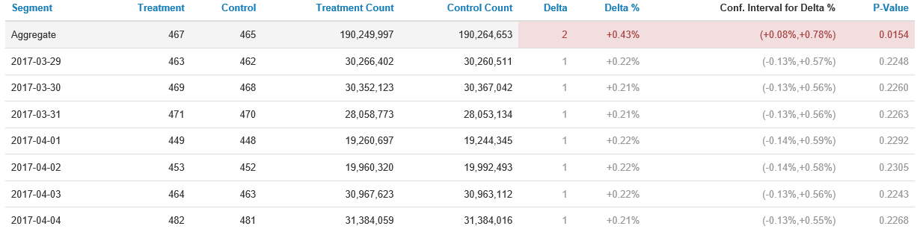
Interesting Non-Issues
Simpson’s Paradox exists in various forms. Consider this real example:

